Slide 1
The Ripple Effect
Lent, Faith and Easter

Slide 2
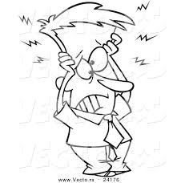
The Question?
Are you ready for Lent…and are you strong enough to take Brother Richard’s Lenten Challenge 2021?????? As we enter these next few weeks of Lent…..

Slide 3
What is that Challenge

Slide 4
There is a reason why it is called the discipline of Lent
A reading from the Letter to the Hebrews 12:4-7, 11-15
The Lord disciplines those he loves.
Brothers and sisters: In your struggle against sin you have not yet resisted to the point of shedding blood. You have also forgotten the exhortation addressed to you as children: / My son, do not disdain the discipline of the Lord / or lose heart when reproved by him; / for whom the Lord loves, he disciplines; / he scourges every son he acknowledges.
Endure your trials as “discipline”; God treats you as his sons. For what “son” is there whom his father does not discipline? At the time, all discipline seems a cause not for joy but for pain, yet later it brings the peaceful fruit of righteousness to those who are trained by it.
So strengthen your drooping hands and your weak knees. Make straight paths for your feet, that what is lame may not be dislocated but healed.
Strive for peace with everyone, and for that holiness without which no one will see the Lord. See to it that no one be deprived of the grace of God, that no bitter root spring up and cause trouble, through which many may become defiled.
The word of the Lord.

Slide 5
Christ tells us we are in the world but not of the world
With what ‘virus’ of a secular culture have you been infected with?
How comfortable are you living in a society which is indifferent to Christ and openly hostile to the Church?
Are you willing to defend the Church, to live the truth that Christ teaches and to be a voice for Christ in a world that wishes to silence Christ?
Are you wiling to stand with Christ in a world that wishes to silence Christ?

Slide 6
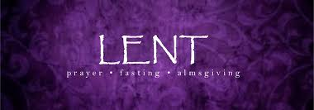
This Lent Matters
Because what plagues our hearts, our family, our Church, nation and world can only be healed through prayer and fasting….
WHY?
Because eternity hangs in the balance

Slide 7
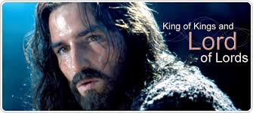
Lent is more than
praying, fasting and almsgiving…although important…what is crucial for a good Lent is a reminder that Lent is about our rediscovery of who Jesus is for us….
Lent is about God’s cause and that cause is you and I
Central to Lent is your relationship with the Person of Jesus Christ

Slide 8
PowerBall of Baptism
You and I have already won…we are sons and daughters of God….
We are members of the Body of Christ
We are called to a unique friendship with the Person of Jesus Christ who is Lord and Savior
Do you accept Jesus as your personal Savior?

Slide 9
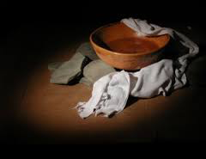
Lent really is about
a question
an invitation
a new commandment
Lent is about learning and then practicing the lesson of the towel, pitcher and the bowl

Slide 10
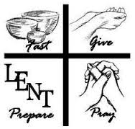
The practical A, B and C’s of a
happy, healthy and holy Lenten Season
Prayer
Fasting
Alms

Slide 11
Prayer, Fasting and Giving
allow us to set priorities…what are your priorities right now!
Some things to consider:
how are you contributing to the common good
do your words, what you think and how you act allow the Gospel of Jesus Christ to become real and authentic as often as possible

Slide 12
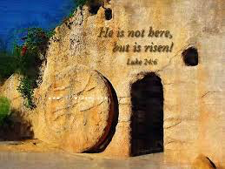
Lent is a workout for…..
the heart and soul………so that you and I can once again remember, celebrate and believe the most incredible event in all of human history…..Easter….

Slide 13
We prepare during Lent
to remind ourselves and others:
THE TOMB IS EMPTY!

Slide 14
Lent and Easter
Challenge you and I to take a hard, deep look at our relationship with the Person of Jesus Christ……..
at the core of this look and relationship is CONVERSION…fancy, religious word that simply means a radical, heart tapping and soul stretching EXTREME SOUL MAKEOVER! that changes attitudes, behaviors, takes responsibility and admits mistakes and is determined with resolve and purpose to do better in that one foundational option Baptism calls us to and that is an authentic relationship with Jesus Christ that literally changes us from the inside out!

Slide 15
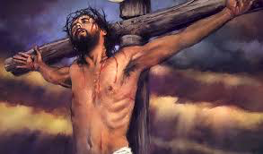
Are you up for the Lenten Challenge
Xtreme Lent……
to fast
to pray
to do good works

Slide 16
Let’s get Ready…..
the A’s of a happy, healthy and holy Lent call us to be aware and attentive….not distracted or disturbed
the B’s of a happy, healthy and holy Lent remind us that we are bound and broken needing to become the blessed and the beloved
the C’s of a happy, healthy and holy Lent caution us about the deadly c’s of chatter, clutter, condemning and complaining and what about control, comfort and compulsion….does any of this sound familiar!

Slide 17
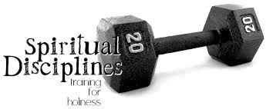
When a D is Good News…..
Dedication – special and set apart
Devotion – developing a practice of praise and worship
Discipline – where real growth in the spirit happens that changes a life….this is the hardest part but one that is necessary for growth to happen……

Slide 18
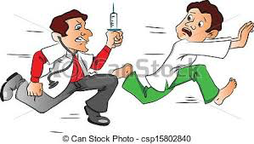
Discipline leads to growth
for growth to happen you need a healthy dose of prayer, fasting and charity on a regular basis and this growth requires attention to the details of not just the body but of the heart and soul…..if a doctor told you that you had a heart problem would you ignore him? probably not…..but how often do we ignore the conditions of our heart and soul!!!!!!

Slide 19
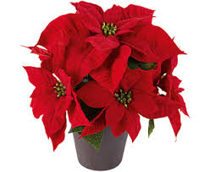
A Lesson for clarity
The Poinsettia vs Amaryllises

Slide 20
This growth needs a
healthy meal of worship and praise…
Regularly……..would you just eat on Easter and Christmas

Slide 21
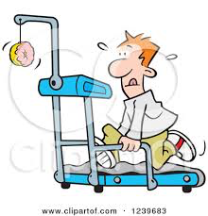
This growth needs the
exercise that moves the metabolism of the heart to burn off the calories of sin and selfishness…..the dreaded S words

Slide 22
Now to the Ripple Effect…..
ripple effect is to the Gospel and Faith what going viral is to the Internet…..

Slide 23
Ripple Effect any ????????

Slide 24
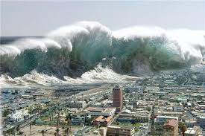
Your Choice??????
want to live with the ripple effect of grace
or with the tsunami of destruction????????

Slide 25
RISEN
https://www.youtube.com/watch?v=hNGeGS_PUA8

Slide 26
Are you Jesus?
When people see you, when you talk to people, when circumstances require a moral compass and the certitude of truth….are you Jesus?
When a stranger needs a hand are you Jesus?
When a loved one needs your time…are you Jesus?
When the world needs love instead of hate….are you Jesus
Lent is about being Jesus in the world today, now as a vessel of prayer, an instrument of charity and the blessing cup of Christ Presence in this world

Slide 27
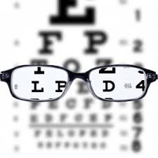
Lent is about
what you see
and what you hear….
what are you looking at?
what are you listening to?

Slide 28
What do you see?

Slide 29
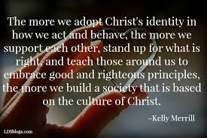
Lent is about
becoming ready for the Resurrection and the creating of a culture of Christ

Slide 30
Lent is about a
renewed personal encounter with Christ….
answering the invitation by a renewal, by personal openness to the power of grace, by an encounter that is meeting Jesus in the Scripture, the Sacraments and one another and by fostering this encounter by meeting Jesus in the ordinary moments of our life….
Where do you and Jesus meet?
Where did you encounter Jesus today?

Slide 31
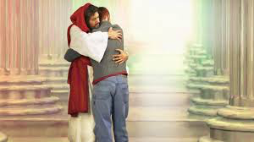
Develop a renewed
attraction and affection for Jesus
what attracts you to Jesus?
how intimate are you with Christ?
this then transforms your life

Slide 32
When Christ
transforms your life then others are attracted and inspired by you…..the more time we spend with Christ, the more we begin to become like Christ so that others can honestly say to us….
Are you Christ?

Slide 33
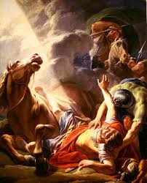
Two important questions?????
Who are you sir?
What shall I do sir?
Are you willing to give an astounding answer to these questions?

Slide 34
Be aware
of the Light of Christ that surrounds you….
of the Light of Christ that you nurture within yourself, heart and soul
of the Light of Christ that you share with others

Slide 35
Be not Afraid…..

Slide 36
Amen
Because He Lives
https://www.youtube.com/watch?v=PBvU7arNhQs

